Slide 1

Mathematics

Slide 2
Session
Matrices and Determinants - 3

Slide 3
Session Objectives
Singular and Non-singular Matrix
2. Adjoint of a Square Matrix and its Properties
3. Inverse of a Matrix and its Properties
Solution of Simultaneous Linear Equations (Matrix Method)
Class Exercise

Slide 4

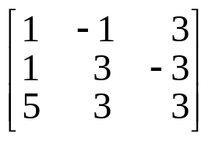
Singular Matrix
A square matrix A is said to be singular if lAl = 0 .
A is non-singular if
For Example:
Let A=
A⎥=1(9+9)+1(3+15)+3(3-15)
= 18+18-36
= 0
A is a singular matrix .

Slide 5
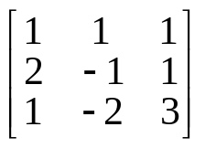

Non-Singular Matrix
Let B=
⎪B⎢= 1(-3+2)-1(6-1)+1(-4+1)
= -1 – 5 – 3
= -9
B is a non-singular matrix.

Slide 6
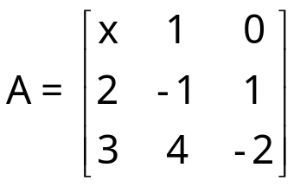
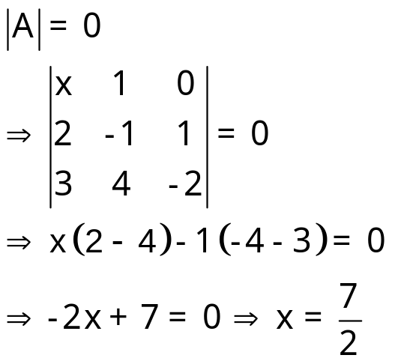
Example -1
Find the value of x for which the matrix
is singular.
Solution:
For matrix A to be singular

Slide 7

Adjoint of a Square Matrix
The transpose of the matrix of cofactors of elements of a square matrix A is called the adjoint of A and is denoted by adjA.

Slide 8
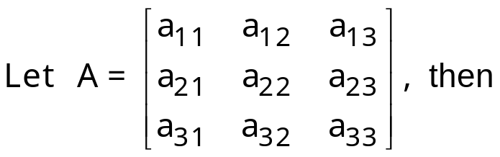
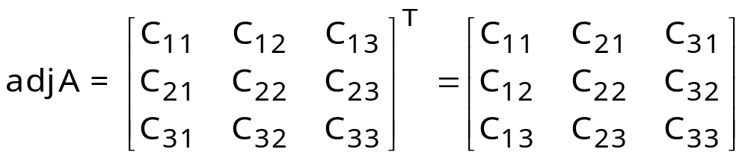
Adjoint of a Square Matrix
where C_{ij} denotes the cofactor of a_{ij} in A.

Slide 9
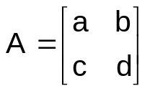
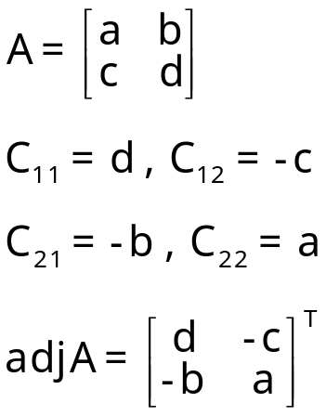
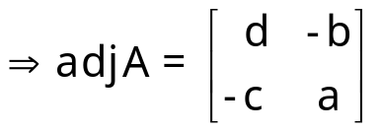
Example - 2
Find the adjoint of matrix
Solution :

Slide 10
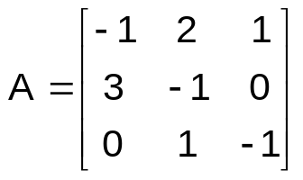
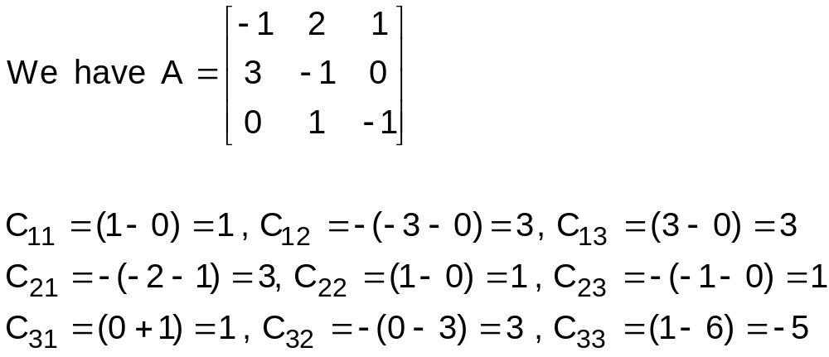
Example - 3
Find the adjoint of matrix
Solution:

Slide 11
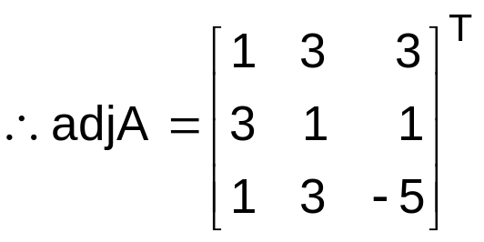
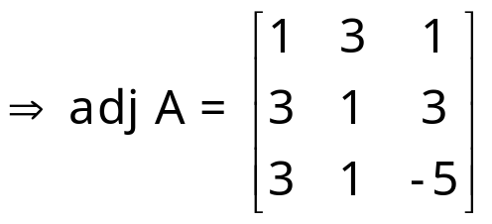
Solution cont.

Slide 12

Properties
A (adjA) = |A| I_{n} = (adjA) A
Proof: Let A = [a_{ij}] be a square matrix and let C_{ij} be cofactor of a_{ij} in A, then (adjA) = [C_{ji}] for all i, j = 1, 2, ..., n

Slide 13
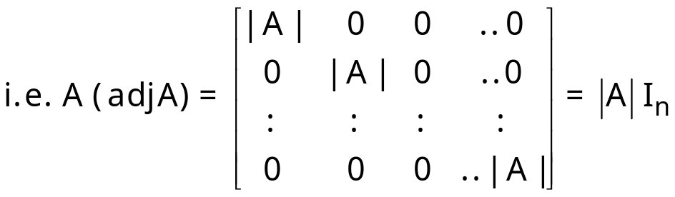

Properties (Con.)
Therefore, each diagonal element of A (adjA) is equal to |A| and all non-diagonal elements are equal to zero.
Hence, A (adjA) = |A| I_{n} = (adjA)A

Slide 14
Properties (Con.)
2. If A is a non-singular square matrix
of order n, then |adjA| = |A|^{n – 1}
3. If A and B are non-singular square
matrices of same order, then
adj AB = (adjB) (adjA)
4. If A is a non-singular square matrix,
then adj (adjA) = |A|^{n–2} A.

Slide 15
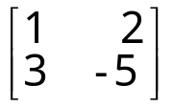
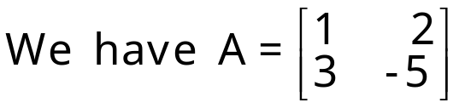
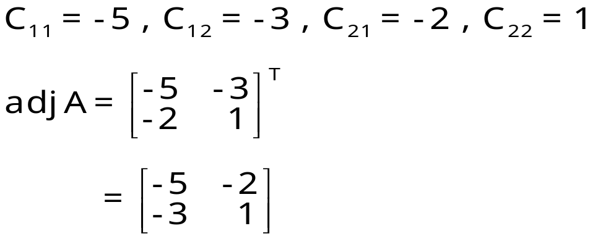
Example-4
Compute the adjoint of matrix A=
and verify that
A(adj A)=|A|I.
Solution:

Slide 16
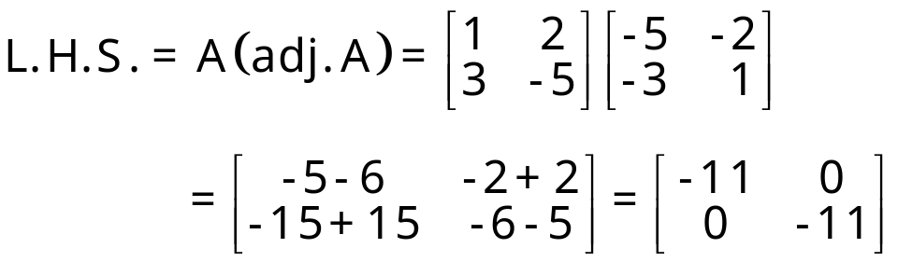
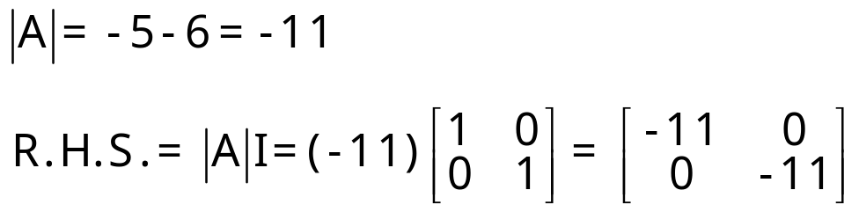

Solution (Con.)
Hence verified.

Slide 17
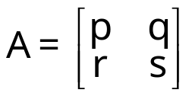

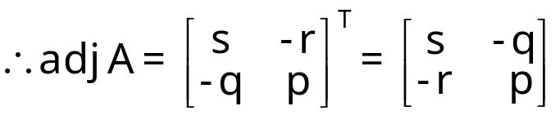
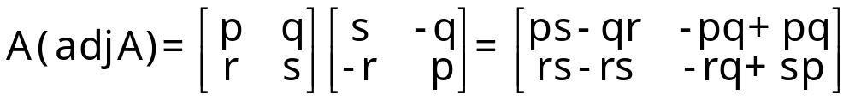
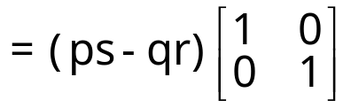
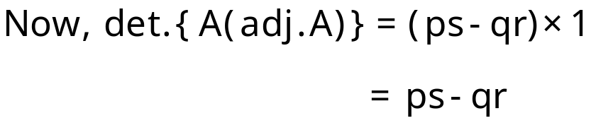
Example-5
If a matrix
, find det. {A(adjA)}.
Solution:

Slide 18
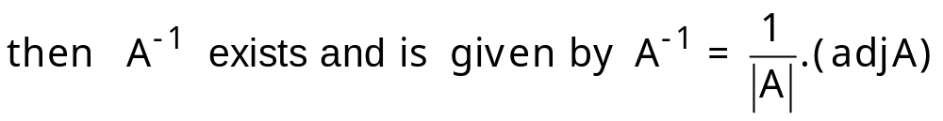

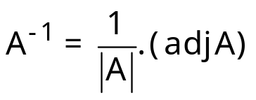
Inverse of a Matrix
Steps to find inverse of a matrix:
(i) Find out |A| and if , then the matrix is invertible.
(ii) Find out (adjA).
Then
Notes:
A non-singular square matrix of order n is invertible if these exists a square matrix B of the same order such that AB = I_{n} = BA. In such a case, we say that the inverse of A is B and we write A^{–1} = B

Slide 19
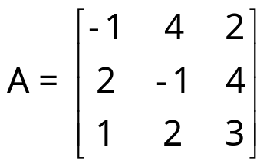
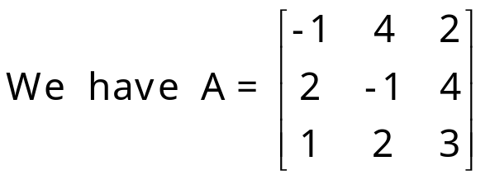
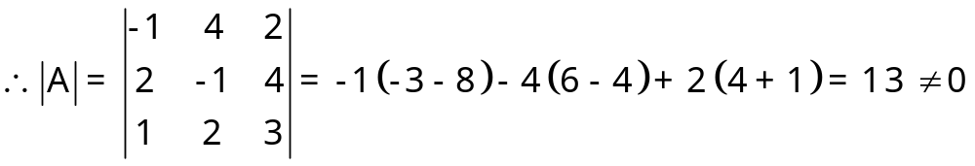
Example-6
Find the inverse of the Matrix
Solution:

Slide 20
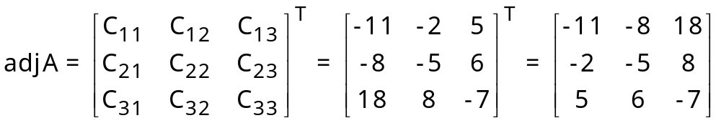
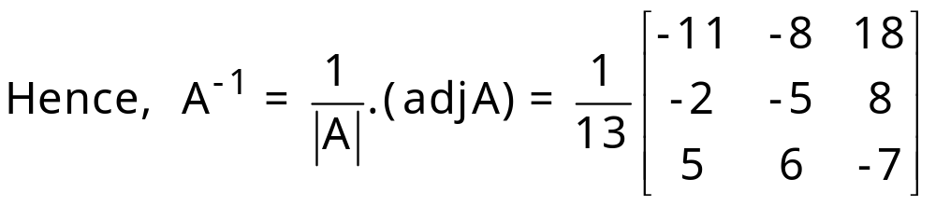
Solution cont.

Slide 21
Properties
A square matrix is invertible if it is non-singular.
(ii) Every invertible matrix possesses a unique inverse.
Proof: Let A be an invertible matrix of
order n x n.
Let B and C be two inverses of A.
Then AB = BA = I_{n}
and AC = CA = I_{n}
Now AB = I_{n}
Multiplying by C C(AB) = CI_{n}
    ⇒(CA)B = C I_{n}
    ⇒I_{n} B = C I_{n}
    ⇒B = C
Hence, an invertible matrix possesses a unique inverse.

Slide 22
Properties (Con.)
(iii) (AB)^{–1} = B^{–1} A^{–1}
or (ABC)^{–1} = C^{–1} B^{–1} A^{–1}
(iv) (A^{T})^{–1} = (A^{–1})^{T}

Slide 23
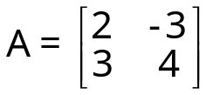
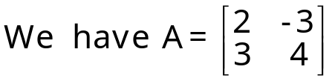
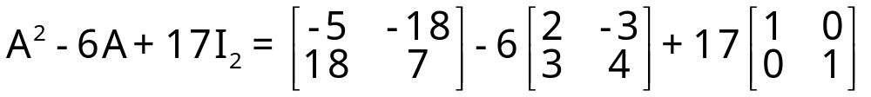
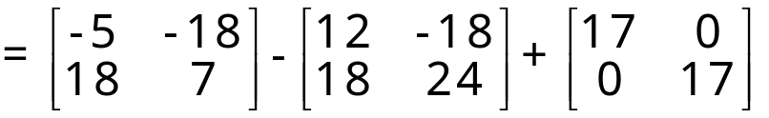
Example-7
Show that
satisfies the equation x² - 6x + 17 = 0.
Hence, find A⁻¹.
Solution:

Slide 24
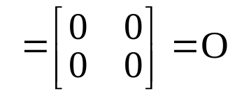

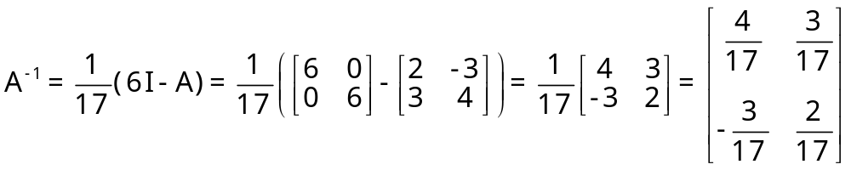
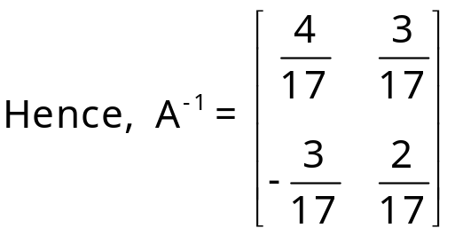
Solution (Cont.)
Hence, A satisfies the equation x² - 6x + 17 = 0.
A² - 6A + 17I = 0
Multiplying each side by A^{-1,} we get
A⁻¹A² - 6(A⁻¹A) + 17(A⁻¹I) = A⁻¹.0
(A⁻¹A)A - 6I + 17A⁻¹ = 0
IA - 6I + 17A⁻¹ = 0, 17A⁻¹ ⁼ 6I - A

Slide 25
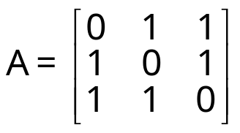
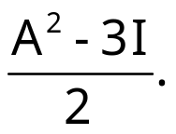
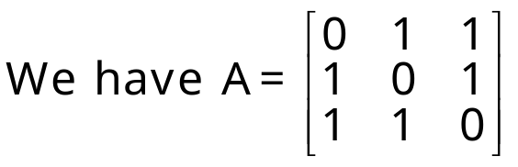
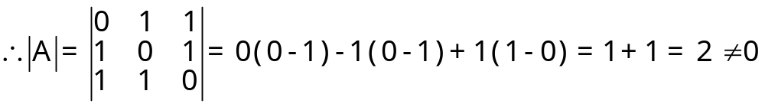
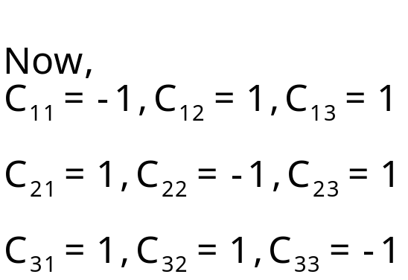
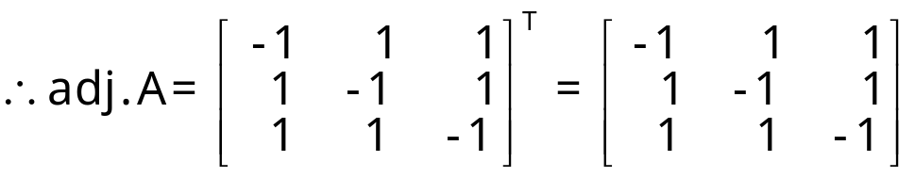
Example-8
Find A⁻¹ , if
. Also show that A⁻¹=
Solution:

Slide 26
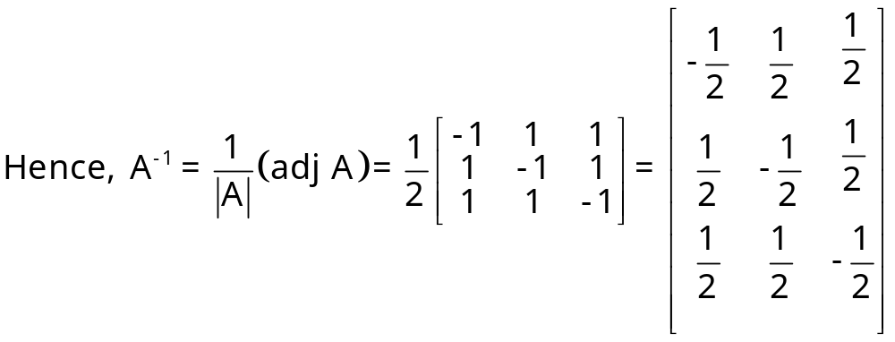
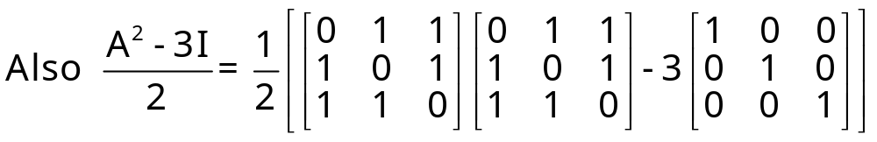
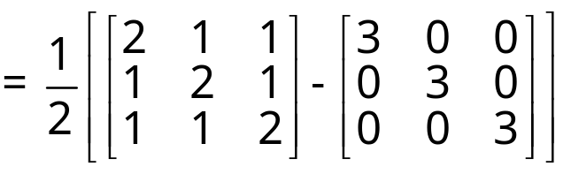
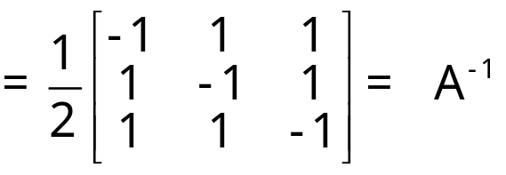
Solution cont.

Slide 27
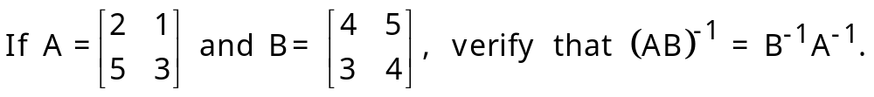
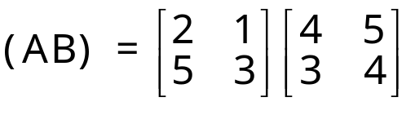


Example-9
Solution:

Slide 28



Solution (Cont.)

Slide 29



Solution of Simultaneous Linear Equations (Matrix Method)
Let the system of 3 linear equations be
This system of linear equation can be written in matrix form as

Slide 30




Solution of Simultaneous Linear Equations (Matrix Method)
The matrix A is called the coefficient matrix of the system of linear equations.
Multiplying (i) by A^{–1,} we get

Slide 31
Important Results
If A is a non-singular matrix, then the system of equations given by AX = B has a unique solution given by X = A^{–1}B
If A is a singular matrix and (adjA)B = 0, then the system of equations given by AX = B is consistent with infinitely many solutions.
(iii) If A is a singular matrix and (adjA)B ≠ 0, then the system of equations given by AX = B is inconsistent.

Slide 32


Example-10
Using matrix method, solve the following system of linear equations
x + 2y -3z = -4
2x + 3y + 2z = 2
3x - 3y - 4z = 11
Solution:
The given system of equations is
x + 2y - 3z = -4 ...(i)
2x + 3y + 2z = 2 …(ii)
3x -3y - 4z = 11 …(iii)

Slide 33


Solution (Cont.)

Slide 34




Solution Cont.

Slide 35



Solution (Con.)

Slide 36


Example-11
Using matrices, solve the following system of equations
x + y + z = 6
x + 2y + 3z = 14
x + 4y + 7z = 30
Solution:
The given system of linear equations is
x + y + z = 6 …(i)
x + 2y + 3z = 14 …(ii)
x + 4y + 7z = 30 …(iii)

Slide 37



Solution (Cont.)

Slide 38




Solution cont.

Slide 39



Solution (Con.)
Putting z = k in first two equations, we get
x + y = 6 - k
x + 2y = 14 - 3k

Slide 40



Solution (Con.)
These values of x, y and z = k also satisfy (iii) equation.

Slide 41

Thank you

